Slide 1

Capstone Project Student’s Early Attrition Modelling for Clear Water State University

Slide 2
About the Project:
1.The Main goal of this Project is to leverage the Data provided by the University to identify the students who are more likely to Attrite
2.Through this project the University hopes to fulfil its Main Goals which are..
Increasing the Enrollment of Students
Increase Retention, Progression and Graduation rates
Recruit better academically qualified Graduate and Undergraduate Students
Increase External funding and Recognition
3.From the Data provided by the university we need to do the following things..
Identify key drivers of Early Attrition
Build a Predictive Model to identify Students with higher Early Attrition Risk
Use the Predictive Model to suggest appropriate Interventions and steps to be taken in order to attain the University’s Goals.

Slide 3
Overview of all the things done in the Project:
1.Data Preprocessing
Removal of features containing very large number of Missing Values and imputing the Missing Values present in all the other features.
After the Missing Value Imputation , Outlier Treatment has been done on some of the Features.
2.Exploratory Data Analysis where I have checked for the Relationships between all of the Independent Features and also the Relationship between Dependent and Independent Features.
Exploring Relationships between Numerical vs Numerical Variables
Categorical vs Numerical Variables
Categorical vs Categorical Variables
Dependent Variable(RETURNED_2ND_YR) vs All the Categorical Variables
3.Encoding of the Categorical Features in the Dataset
Different categorical features were encoded in different ways such as Frequency Imputation, Mode Imputation , Ordinal Number Imputation etc.
4.Fitting the Resultant Dataset to models Like Logistic Regression and Decision Trees
Here for each of the Models like Logistic Regression and Decision Trees I have done several iterations of model building for each of the Models to see which one gives us the Best Accuracy along with predicting most of the Majority and Minority classes correctly.
To ensure this happens i used various evaluation metrics like Confusion-Matrix,AUC-R0C score and F1 Score etc.

Slide 4
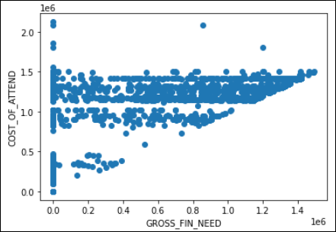
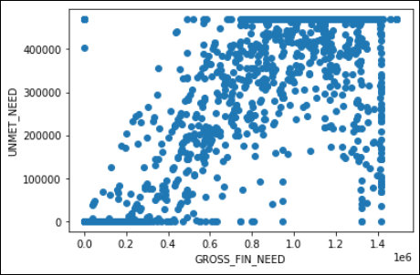
Main Takeaways and Insights Exploratory Data Analysis
For me in the EDA part the main Aim was to check for any Multicollinearity between the Independent Variables
Relationship between the Numerical Variables:
→ Relationship between “COST_OF_ATTEND”, “GROSS_FIN_NEED”
There is a minute trend of linearity here but nothing of any significance
The correlation between the two features is almost equal to 0.65 which
isn’t that significant.
→ Relationship between “UNMET_NEED” , “GROSS_FIN_NEED”
It seems to have a good amount of linear relationship.
The correlation between them is almost equal to 0.9 which means that they
do have some multicollinearity between them

Slide 5
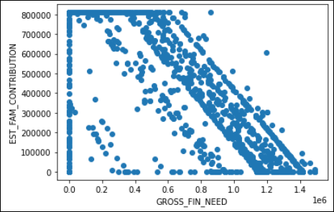
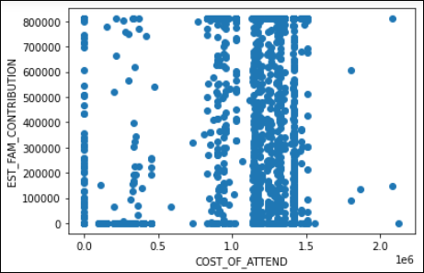
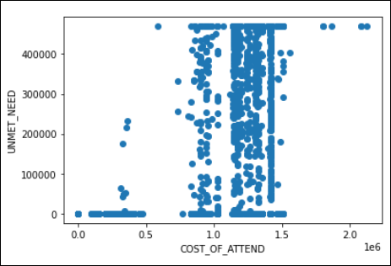
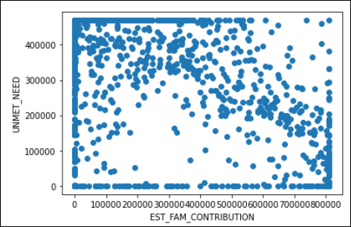
Continuation….
All of the scatter plots here between their respective features do not have
any Linear relationship between them.
The correlation between each one of these pairs is almost equal to 0.5
which is not at all an indication of any Multicollinearity between any of
these pairs of Features.

Slide 6
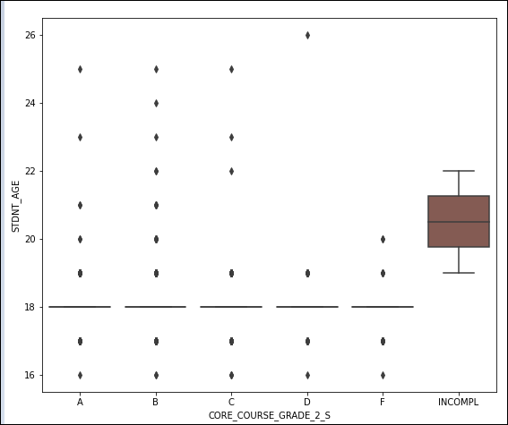
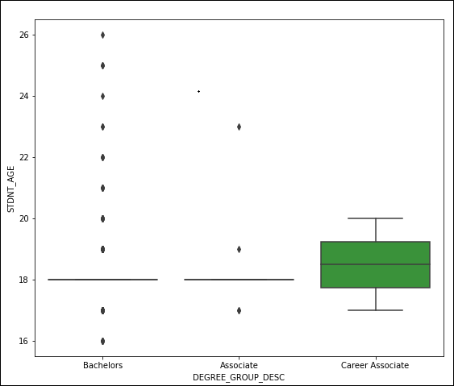
Continuation….
Relationship between Categorical and Numerical Variables:
Mean “STDNT_AGE” for feature “CORE_COURSE_2_S” in “INCOMPL” category is almost equal to 20.5
Mean “STDNT_AGE” for feature “DEGREE_GROUP_DESC” in “Career Associate” category is slightly greater than 18.
For rest of all the CATEGORICAL FEATURES in all of their respective CATEGORIES the Mean “STDNT_AGE” is 18.
And also the Mean “DIST_FROM_HOME” for all the categories in their respective categorical features is 0.From which we can infer that almost all of the students stay in the campus or really close to the Campus.

Slide 7
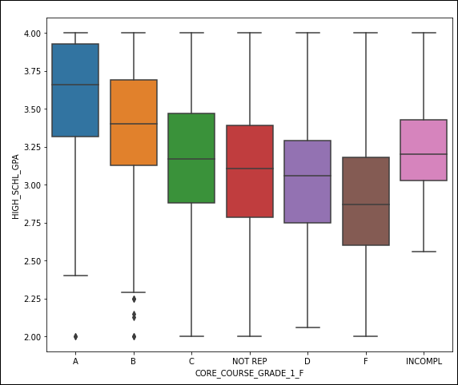
Continuation….
The Mean “HIGH_SCHL_GPA” is the highest for the students who got an “A” grade in their “CORE_COURSE_GRADE_1_F” and the mean “HIGH_SCHL_GPA” follows a decreasing trend from students with grades B,C,D,F and we observe some variations with the other different categories like “NOT_REP” , “INCOMPL” etc.
The EXACT same trend is observed in the categorical features “CORE_COURSE_GRADE_2_F_nan”, “CORE_COURSE_GRADE_1_S” and “CORE_COURSE_GRADE_2_S”.
SOME OTHER TRENDS OBSERVED APART FROM THE ONES IN THIS BOXPLOT ARE:
Females have a slightly higher Mean “HIGH_SCHL_GPA” than Males
Among the Different Backgrounds that students belong to….students belonging to “BGD 8” have the highest Mean “HIGH_SCHL_GPA”

Slide 8
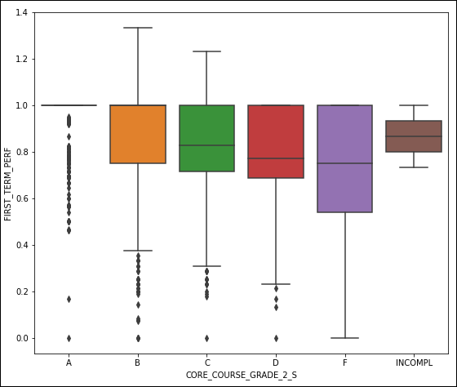
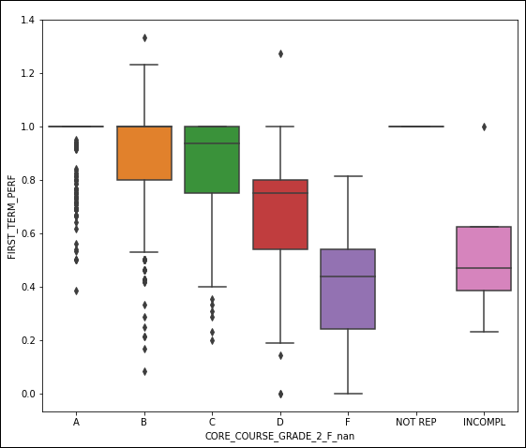
Continuation….
The “FIRST_TERM_PERF” and “SECOND_TERM_PERF” features are calculated as “EARNED_HRS”/”ATTEMPTED_HRS” in the respective “Terms” for the respective Features.
→The Mean “FIRST_TERM_PERF” decreases from the grades C,D,F for the “CORE_COURSE_GRADE_2_S” variable.
→The same EXACT trend is observed in “CORE_COURSE_GRADE_2_F_nan Variable too. The Mean “FIRST_TERM_PERF” decreases from the grades C,D,F.
And for the “SECOND_TERM_PERF” variable also the same EXACT trend is observed for both of the variables “CORE_COURSE_GRADE_2_S” and “CORE_COURSE_GRADE_2_F_nan” respectively.

Slide 9
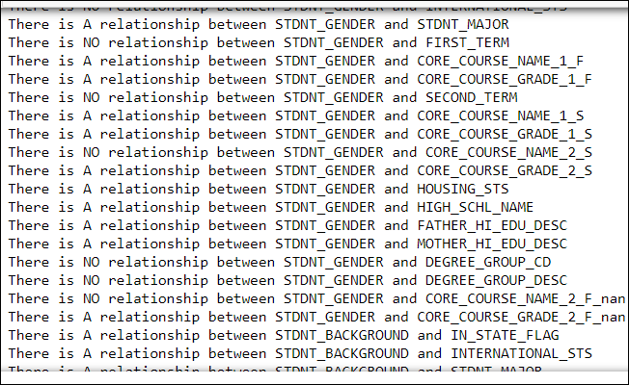
Continuation….
Relationship between all Categorical Variables:
The Image here shows us whether there is an Association between any two Categorical Variables by using a Function created in the Jupyter Notebook.
The Function uses the Chi-Square test of Association from the “sci-py” library
The “Chi-Square Test of Independence/Association” is applied when we have two Categorical Variables from a single population.It is used to determine whether there is a Significant Association between the two variables.
Here the Null and Alternate Hypothesis would be:
Ho: Variable A and Variable B are independent
Ha: Variable A and Variable B are NOT independent

Slide 10
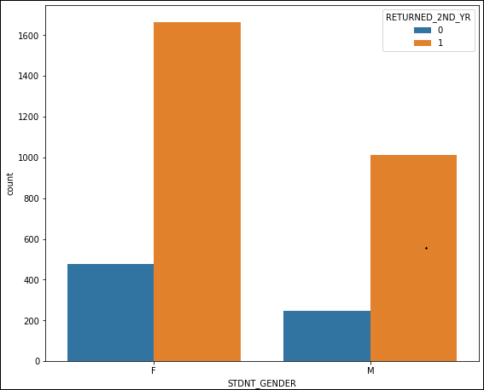
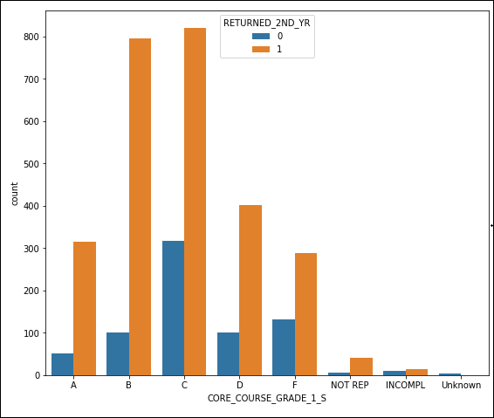
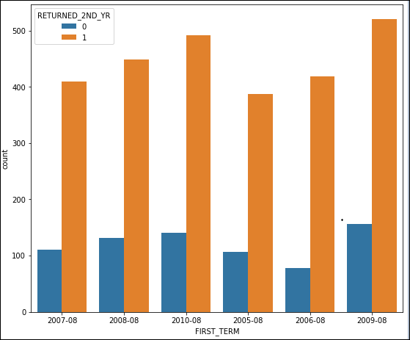
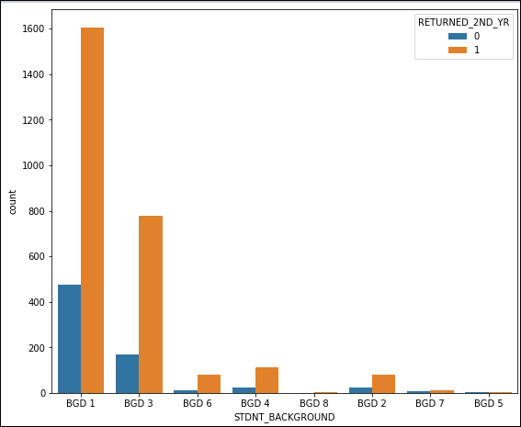
Continuation….
Here are some of the Countplots between the various Independent Categorical Features and the Dependent Feature “RETURNED_2ND_YR” where 0 means that the student has Attrited whereas 1 means the student didn’t Attrite.
As we see we can notice some things from the countplots like the Females have Attrited more in number than Males.
The Highest Attrition for the University in terms of numbers was recorded in the year 2009
The “RETURNED_2ND_YR” variable was converted to a new feature called “Attrition” during the Data Pre-processing stage.In the “Attrition” variable 1 represents that the student has Attrited whereas 0 represents students who did not Attrite.

Slide 11
Modelling Process:
After all the Data Pre-processing and Encoding I have done the resultant dataset contained 3400 rows and 31 columns.
I tried fitting the Data into two different kinds of Models-Logistic Regression and Decision Trees.For both the different kinds of Models I used different kinds of dataset.For the Logistic Regression Model I used an Encoded dataset whereas for the Decision Tree I used a dataset which was not Encoded and instead created Dummy Variables for all of the Categorical columns present.
For both Logistic Regression and Decision Tree I created various iterations of the same model of each kind in order to get the desired result.I used various techniques like varying the Threshold for the Classification,plotting the AUC-ROC,Precision-Recall curves, Recursive feature Elimination(RFE),using arguments like “class_weight” while initiating the model and also “Upsampling” for Logistic Regression and for Decision Trees I used techniques like GridSearchCV, Feature Selection according to the feature importance of the Variables, Pruning the Tree and also “Upsampled” the dataset so that it could predict both the Minority and Majority classes correctly and have a good F1-Score.
With Logistic Regression I was not able get the desired results so my ultimate final result was obtained using the Decision Trees…so the slides forward will interpret only the Final Model.
All of the processes and what are all the things done in multiple number of iterations for each model is well documented in the Python Notebook for the reference.

Slide 12
Decision Tree:
After the “Upsampling” of the data to handle the Imbalance among the Classes…fitting the data with a Decision Tree of depth 11(obtained from GridSearchCV results) we get an accuracy score of 79.6% and an impressive F1-Score of 0.813.
We get Area Under the ROC curve as 0.84 which tells us that 84% of the time the model correctly distinguishes and predicts 2 observations as 1 and 0 respectively.
For max_depth=11 we get a very large decision tree which is slightly difficult to visualize and its not at all clear in the image but I will break it down in the forward slides.Below is an image of the final Decision Tree.

Slide 13
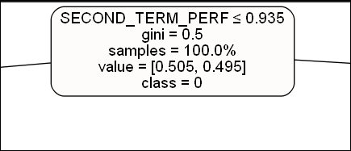
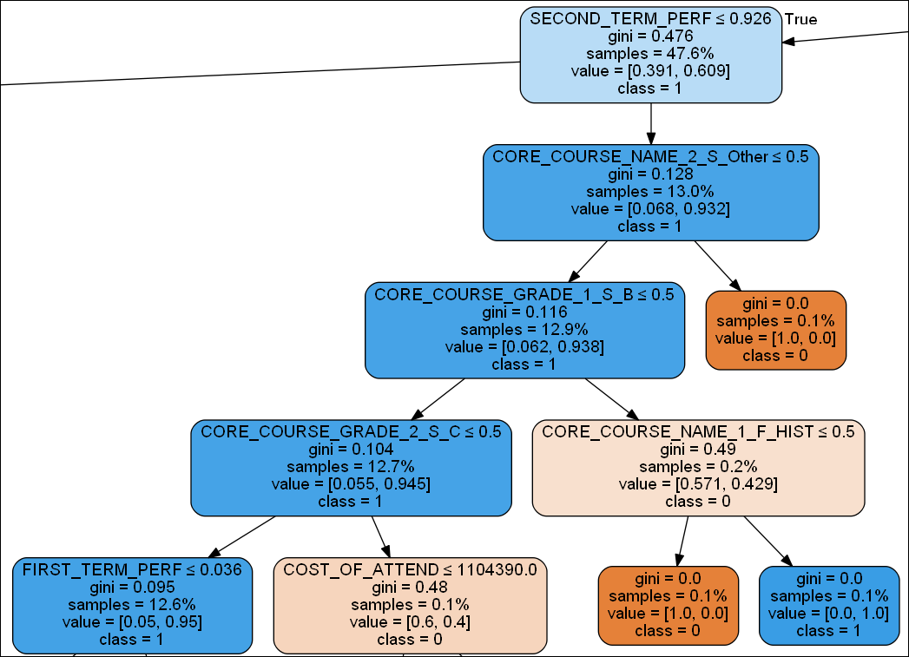
Continuation….
For “SECOND_TERM_PERF”<=0.935 at the Root node we get a sample size of 47.6% out of the total of 4283 records in training dataset and out of those 47.6% sample size we have 60.9% of Attrition(1’s) and 39.1% of students who returned to college after the SECOND_TERM(0’s)
For “SECOND_TERM_PERF”>0.926 we get a sample of 13% out of 47.6% sample earlier in which we have 93.2%-1’s and 6.8%-0’s.
For “CORE_COURSE_NAME_2_S_OTHER”<=0.5 i.e students who took courses which were less in observations in the Dataset which have been termed as “Others” during Data Pre-processing we have a sample of 12.9% out of the 13% sample above which contain 93.8%-1’s and 6.2%-0’s.
For “CORE_COURSE_GRADE_1_S_B”<=0.5 i.e for the students who did not get a “B” grade in the core course 1 of second term we get a sample of 12.7% out of 12.9% sample above in which we have 94.5%-1’s and 5.5%-0’s
For “CORE_COURSE_GRADE_2_S_C”<=0.5 i.e students who did not get a “C” grade in core course 2 in second term,we get a sample of 12.6% out of the 12.7% sample above in which we have 95%-1’s and 5%-0’s.

Slide 14
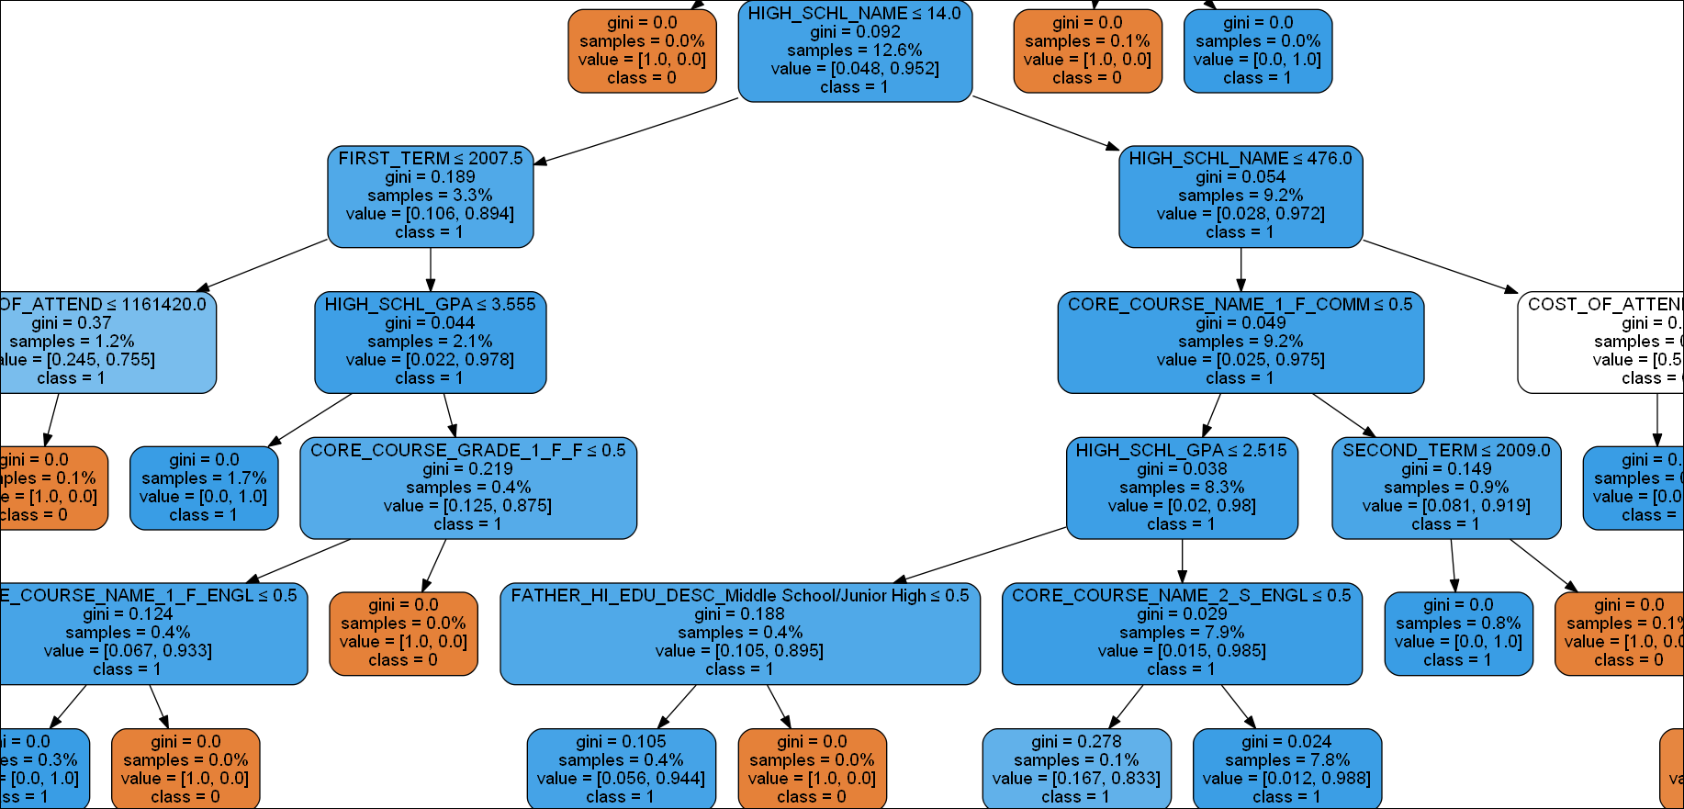
Continuation….
For “FIRST_TERM_PERF”>0.036 we get a sample of 12.6% from the 12.6% sample in the previous slide image.Here we have 95.2%-1’s and 4.8%-0’s.
For “HIGH_SCHL_NAME”>14 we get a sample of 9.2% sample from the 12.6% sample above.Here we have 97.2%-1’s and 2.8%-0’s.
For “HIGH_SCHL_NAME”<=476 we get a sample of 9.2% from the 9.2% sample above.Here we have 97.5%-1’s and 2.5%-0’s
For “CORE_COURSE_NAME_1_F_COMM”<=0.5 i.e for students who have opted for Commerce as their core course 1 in FIRST_TERM we get a sample of 8.3% from the 9.2% sample above.Here we have 98%-1’s and 2%-0’s.
For “HIGH_SCHL_GPA”>2.515 we get a sample of 7.9% from the sample of 8.3% above.Here we have 98.5%-1’s and 1.5%-0’s.
For “CORE_COURSE_NAME_2_S_ENGL”>0.5 i.e for students who took English as their core course 2 in the Second Term we get a sample of 7.8% from the 7.9% sample above.Here we have 98.8%-1’s and 1.2%-0’s

Slide 15
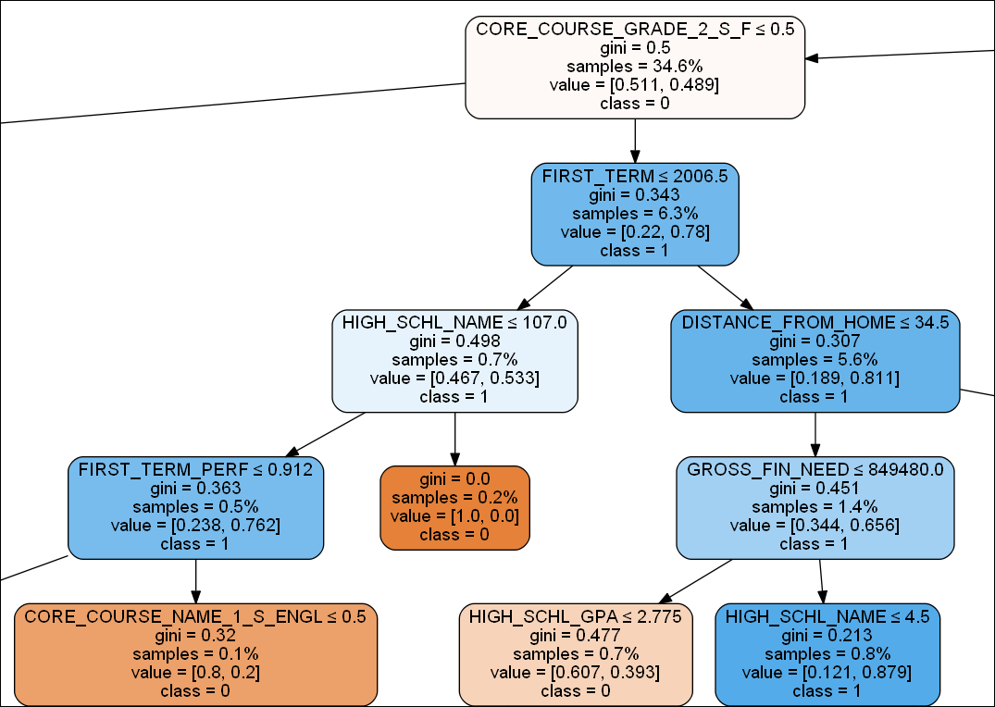
Continuation….
For “SECOND_TERM_PERF”<=0.926(from the first tree slide)we get a sample of 34.6% from the 47.6% sample previously.Here we have 48.9%-1’s and 51.1%-0’s.
For “CORE_COURSE_GRADE_2_S_F”>0.5 i.e for the students who got grade “F” in their core course 2 in second term we get a sample of 6.3% from the 34.% sample above.Here we have 78%-1’s and 22%-0’s.
For “FIRST_TERM”>2006.5 i.e students who joined the college after the year 2006 we get a sample of 5.6% from the 6.3% sample above.Here we have 81.1%-1’s and 18.9%-0’s.
For “DISTANCE_FROM_HOME”<=34.5 i.e for students who stay on or near the university we get a sample of 1.4% out of the 5.6% sample above.Here we have 65.6%-1’s and 34.4%-0’s.
For “GROSS_FIN_NEED”>849480 we get a sample of 0.8% out of the 1.4% sample above.Here we have 87.9%-1’s and 12.1%-0’s.
Since this is a really large Decision Tree it would be quite a long presentation to explain each of the Individual Branches.I have explained some of the branches in the previous two slides including this one.So now lets go find out which all Features are the “Key Drivers of Attrition”.

Slide 16
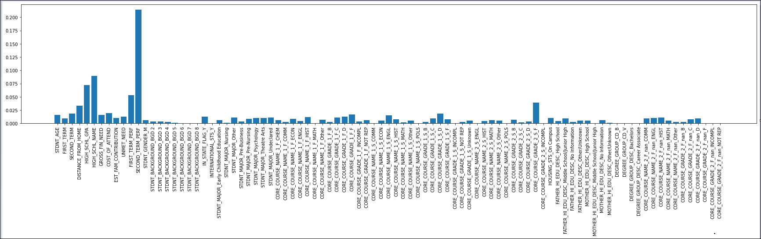
Key Drivers of Attrition
From the Feature Importance we can get which all features are used in a chronological order to paint the Decision Tree so that we would get the Maximum “Information Gain” possible from the Decision Tree.So it would only be logical to call the features with the most importance as one of the “Key Drivers of Attrition”.Below is a Bar Chart of the Feature Importance of each of the features in the Dataset.

Slide 17
Continuation….
Most of the features were of little importance to the whole Decision Tree but they do have an impact when it comes to predicting the Minority Classes as a whole. The Top features with the Most Importance are….
“SECOND_TERM_PERF” – This variable shows us the Amount of Grade points earned by the student out of the total number of Grade Points attempted by the student in the “Second Term”.
“HIGH_SCHL_NAME” – Each High school has a unique number attached to it according to the Dataset
“HIGH_SCHL_GPA” – This is the Student’s High School GPA Score
“FIRST_TERM_PERF” -- This variable shows us the Amount of Grade points earned by the student out of the total number of Grade Points attempted by the student in the “First Term”.
“CORE_COURSE_GRADE_2_S_F” -- This Feature indicates Grade in Core Course 2 opted in First Semester
“DISTANCE_FROM_HOME”– Distance from the University to Student’s Home.
“COST_OF_ATTEND” – This shows us the Course Fees of a particular Student.

Slide 18
Continuation….
Details on how the features could be the “Key Drivers of Attrition”
In the Decision Tree we could see that For “SECOND_TERM_PERF”<=0.935 at the Root node we get a sample size of 47.6% out of the total of 4283 records, out of those 47.6% sample size we have 60.9% of Attrition(1’s) and 39.1% of students who returned to college after the SECOND_TERM(0’s).Here we are getting a lot of information gain about the Attrition right in the first step.After this for “SECOND_TERM_PERF”>0.926 we get a sample of 13% out of 47.6% sample earlier in which we have 93.2%-1’s and 6.8%-0’s.
That is it….we got a ton of information about the Attrition right in this step 93.2% of the students from this sample have Attrited so there is no doubt that this Feature is one of the Key Drivers of Attrition.
2. In the Decision Tree for “HIGH_SCHL_NAME”>14 we get a sample of 9.2% sample from the 12.6% sample above.Here we have 97.2%-1’s and 2.8%-0’s and for “HIGH_SCHL_NAME”<=476 we get a sample of 9.2% from the 9.2% sample above.Here we have 97.5%-1’s and 2.5%-0’s.Here also we are getting a lot of information about the Attrition.
3. For “HIGH_SCHL_GPA”>2.515 we get a sample of 7.9% from the sample of 8.3% above.Here we have 98.5%-1’s and 1.5%-0’s in the Decision Tree.So this too gives us a lot of information about the Attrition.
4. For “FIRST_TERM_PERF”>0.036 we get a sample of 12.6% from the 12.6% sample in the previous slide image.Here we have 95.2%-1’s and 4.8%-0’s.

Slide 19
Continuation….
5. For “CORE_COURSE_GRADE_2_S_F”>0.5 i.e for the students who got grade “F” in their core course 2 in second term we get a sample of 6.3% from the 34.% sample above.Here we have 78%-1’s and 22%-0’s.
6. For “DISTANCE_FROM_HOME”<=34.5 i.e for students who stay on or near the university we get a sample of 1.4% out of the 5.6% sample above.Here we have 65.6%-1’s and 34.4%-0’s.
7. For “COST_OF_ATTEND”<=1297170.0 we get a sample of 1.5% from a 2.1% sample previously.Here we have 55.4%-1’s and 44.6%-0’s.
So All of these Features gives us more Information, like at what particular areas or categories of students the Attrition is Majorly happening.
List of features which also have a little bit of an Importance are…..
“CORE_COURSE_GRADE_1_S_D”
“SECOND_TERM”
“CORE_COURSE_GRADE_1_F_F”
“STDNT_AGE”
“GROSS_FIN_NEED”
“CORE_COURSE_NAME_1_S_ENGL”

Slide 20
Recommended Interventions based on the Model
From the Model that is built and the “Key Drivers of Attrition” the following measures can be taken to reduce the Attrition rate of Students in the University.
Since it is observed that “SECOND_TERM_PERF” is one of the Key Drivers of Attrition..infact it’s the feature with the most importance.
So what the University could do here is that it could offer better Student support by providing students who are not performing well, with extra guidance or extra classes after college hours so that they could gain the knowledge and catch up with other students in performing better. The faculty at the university can also make an effort to form a more healthy relationship with the students so that it would lead to a more positive environment of Learning.
“HIGH_SCHL_NAME” is also a key driver of Attrition. Here we can assume that the students coming from these High Schools did not perform well in their school level and hence their performance is also getting affected due to it.
Since one of the university’s goal is to recruit better academically qualified undergraduate and graduate students it should probably do a thorough background check on the performance of the Students at their school level so that it can recruit better students whom they consider to be capable of performing well at the university level
Next comes “HIGH_SCHL_GPA”.In the Desicion Tree the “HIGH_SCHL_GPA” node comes below the “HIGH_SCHL_NAME” node.This is in direct connection to the “HIGH_SCHL_NAME”…..its the same…
The students coming from those particular High School did not do well at their School level and hence their “HIGH_SCHL_GPA” is also low.Again here the University needs to do a thorough background check on the performance of students at their school level.
Most Importantly the University needs to put special focus and attention to the students who are not performing well.Doing this they could increase the Retention,Progression and Graduation Rates which in turn lead the university to get better overall results which in turn may grab the attention of public and others so this may lead to increased enrollment of students and also increased funding to the University.All of these are interconnected with one another.

Slide 21
Continuation….
“FIRST_TERM_PERF” is another key driver of Attrition.The “FIRST_TERM_PERF” node comes before the “HIGH_SCHL_NAME” node in the Decision Tree.This might suggest that there could be some students who even though performed well at their School level are having some difficulty catching up to the university subject’s.
Here also the same thing applies as at the “SECOND_TERM_PERF”….the university needs to provide better Student Support and help the students who are finding it difficult to cope up with the subjects by providing them with extra classes after college hours etc.
“CORE_COURSE_GRADE_2_S_F” all the students who are getting grade “F” in their core course 2 in second term have good “HIGH_SCHL_GPA”…..maybe…maybe not.What the university could do here is that it could guide the students to select this particular subject carefully so it wouldn’t be burden to them and they could complete that particular subject easily without getting stressed out and ultimately leading to Attrition.
“DISTANCE_FROM_HOME”.My take in this is that this feature is affected by all the features previously mentioned.Since almost 95% of the students are either on or near to the campus all of the other Key drivers are collectively making this feature one of the key drivers of Attrition too.So again the University needs to focus on the measures mentioned earlier.
“COST_OF_ATTEND”.We have a handful amount of sample of students attriting due to the Course Fees for them.But still in this case the University can improve its Scholarship program and provide better scholarships to the students who are performing well in the university or who have performed well in school and have a good “HIGH_SCHL_GPA”.

Slide 22
Thank You
Project done by…
Abhinav Banisetti
abhinavbanisetti2001@gmail.com
Jig20144

Slide 23
About the Project:

